Slide 1
Session 4

Slide 2
Content of session
01
02
03
Recap
Signals
04
Game Idea
Game ???

Slide 3
01
Recap

Slide 4
Movement Physics Instantiation Animation Tile map
Recap

Slide 5
02
Signals

Slide 6
Signals
Signals are a way for objects to communicate and send information with each other in the game world.
A Rule of thumb in games, is that an object should NOT change another object’s value.
But it can send it information to use, in the form of signals.
We’ve encountered signals before, like in the area2D and Physics nodes, but today we’ll learn more about them.

Slide 7
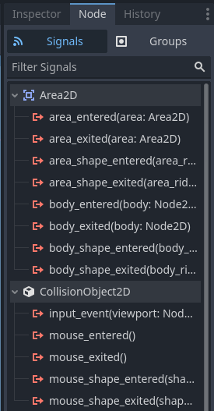
Ready-made Signals
Ready-made signals are signals that are available for their respective nodes and can be connected quickly.
We double click on the signal we want and choose the scrip to connect it to, and press connect
Note: signals need to connect to a script, so don’t forget to have one ready

Slide 8
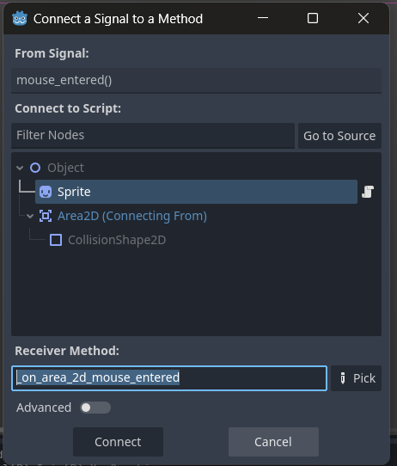

Slide 9

After we’ve clicked connect; the corresponding function appears in our code
We can then write out code here!

Slide 10
Custom Signals
Custom signals are for functionality that’s not available in our nodes.
Like increasing score or health when something happens.
Or updating UI
Making changes in other objects/nodes.

Slide 11

Custom Signals
Custom signals must be defined in the script, like so.
We start with the keyword signal, followed by the signal name. Signal names are past tense verbs.
We can also give our signal a parameter which will be passed when we call the signal.

Slide 12
Custom Signals
We then call our signal at in our code at the place we want it to send its information.
To have it “send” it, we use the emit function, like so.

Slide 13
Custom Signals
For the “receiver” node, first we need to define the node that created the signal.
We can do that with two ways:
Either using @onready var
Or, using referencing it in the _ready() function.

Slide 14

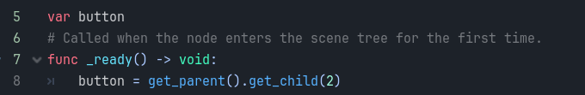
Custom Signals
First Method:
Second Method:

Slide 15
Custom Signals
The last step is to “connect” our signal, which means it will now be “listening” to the information the “sender” transmits.
We do that by calling the connect function on the signal. We usually do this inside the _ready() function.
Inside the connect() function, we put the function we want to call when signal gets called and will receive the parameter.

Slide 16
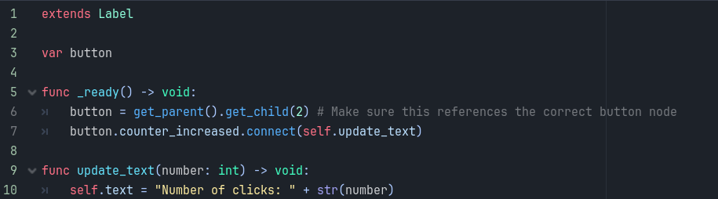
Custom Signals
The function inside the () will be called and execute what’s written inside. Here’s the whole code.

Slide 17
03
Game Ideas

Slide 18
How to get Game Ideas?

Slide 19
04
Game ???

Slide 20
GAME JAM

Slide 21
What is a Game Jam?

Slide 22
How to Game Jam?

Slide 23
Game Jam
How to find Game Idea.
How to look for Game assets.
How to design the Game.
How to think about Gameplay.

Slide 24
Don’t forget the Task!

Slide 25
Thanks!
Any Questions

